Slide 1

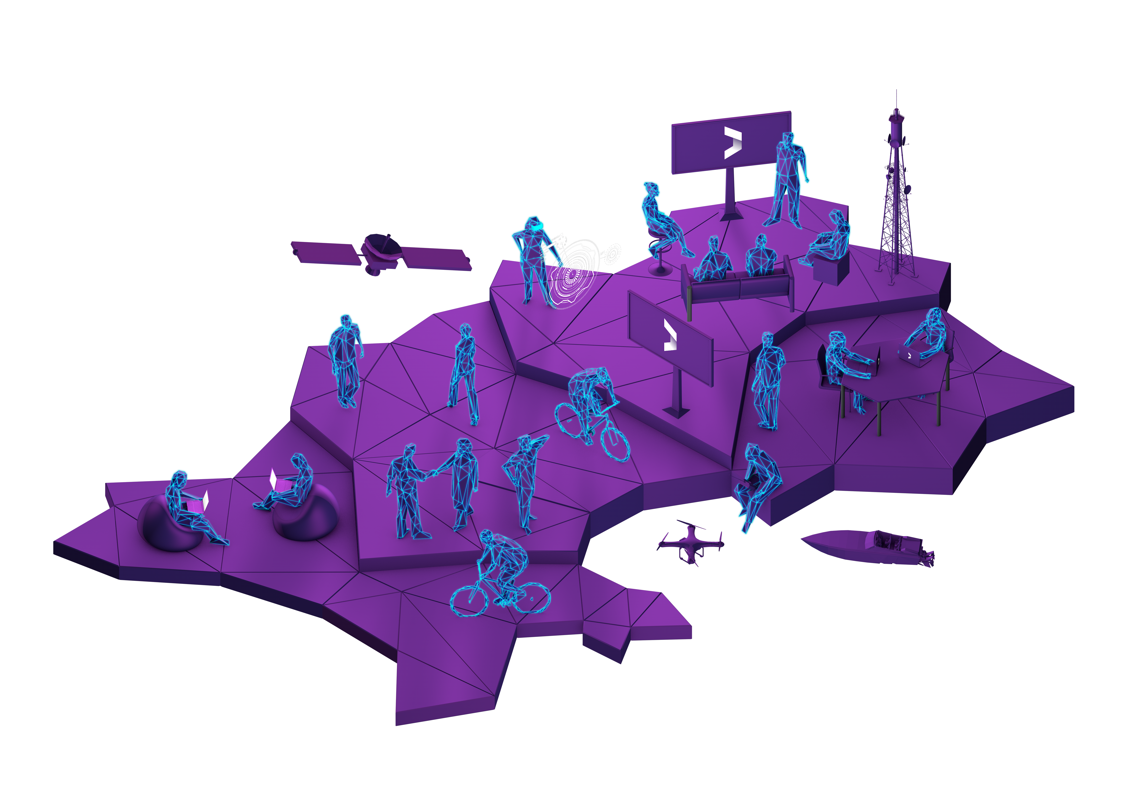


Sandbox Jersey
#sandboxjersey
Wifi: techUK
Password: STB9897321

Slide 2
Sandbox Jersey
Tony Moretta, CEO

Slide 3
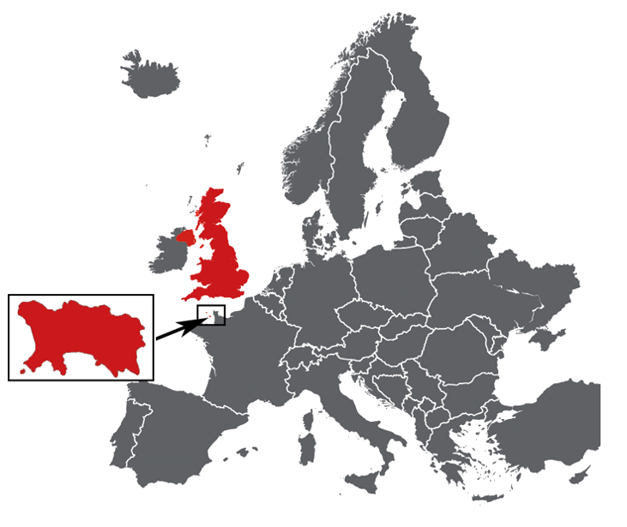
About Jersey
Self-governing parliamentary democracy
Crown Dependency and not part of the UK
Treated as part of EU for free trade not a part of the EU.

Slide 4
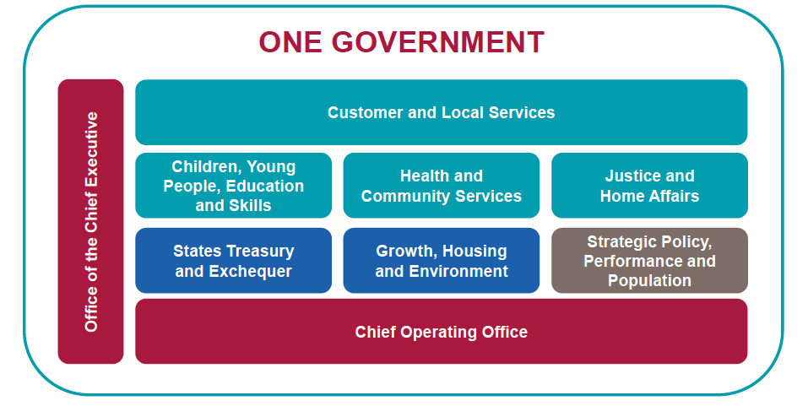


Slide 5







Infrastructure

Slide 6
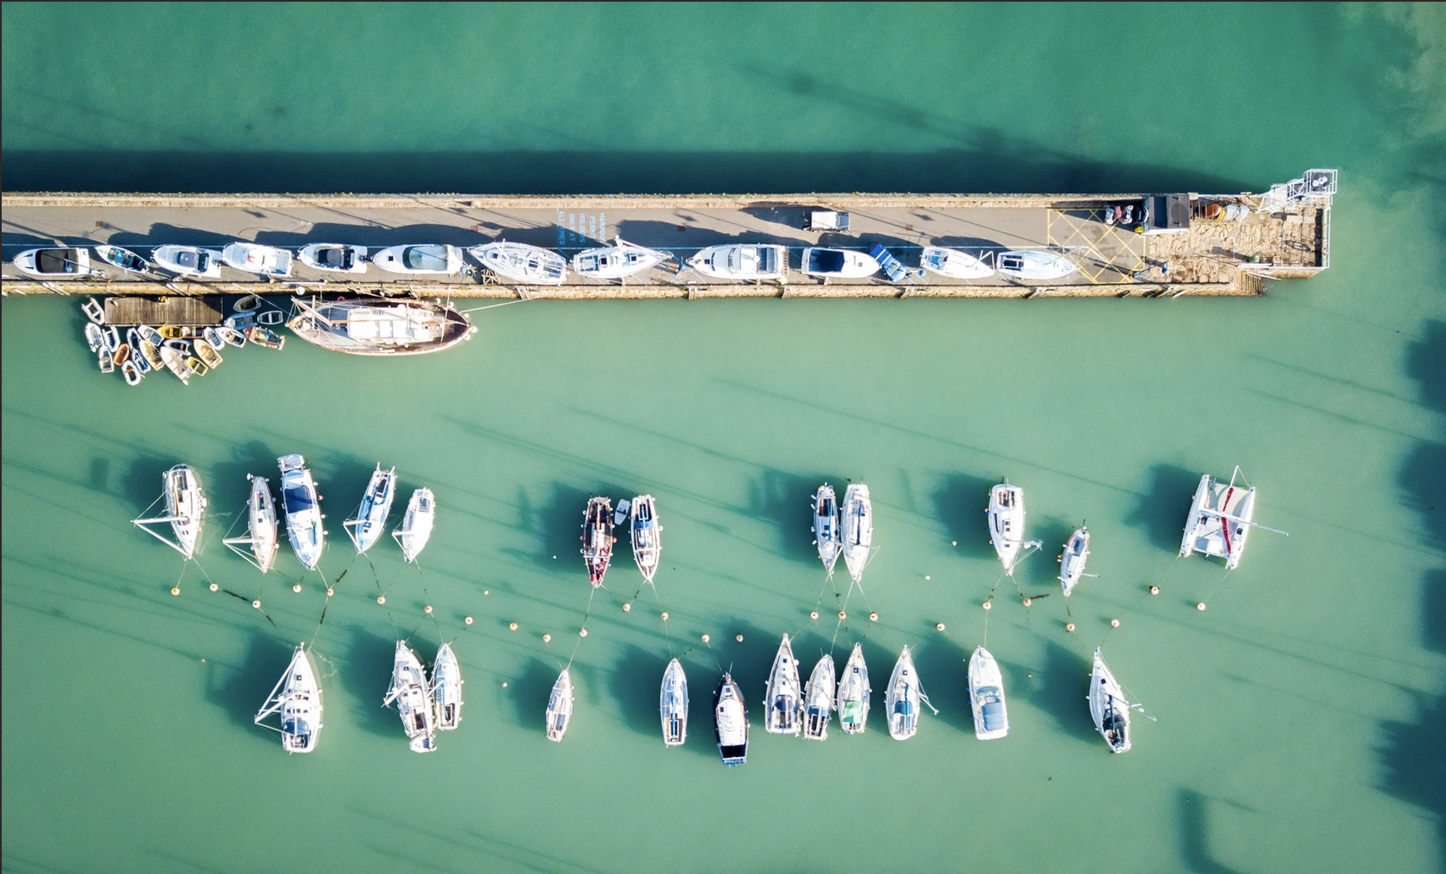
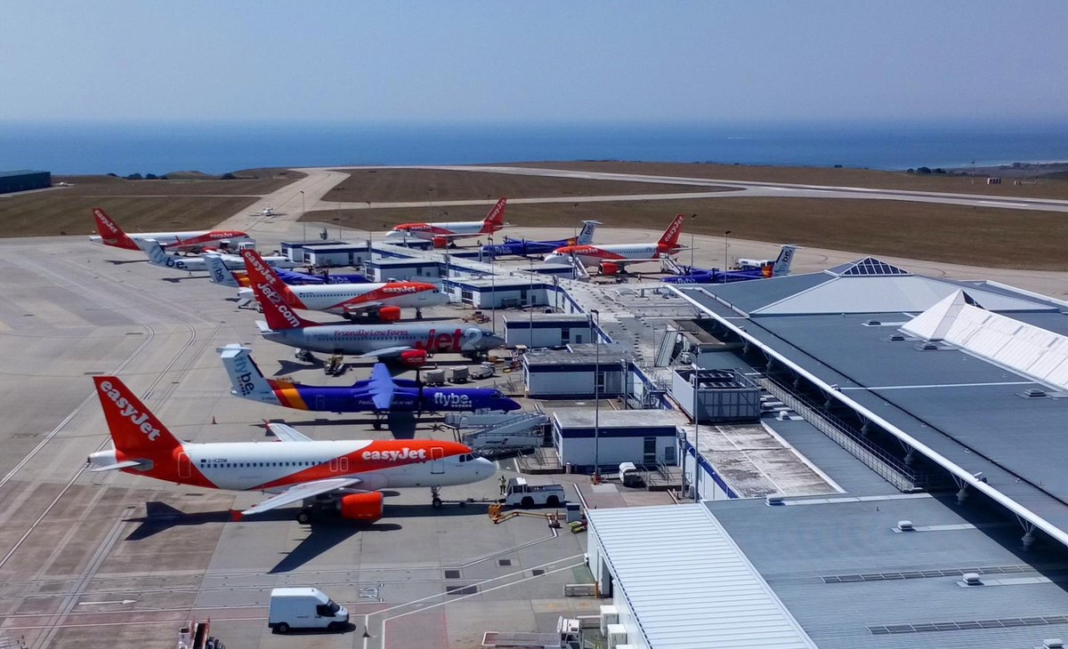
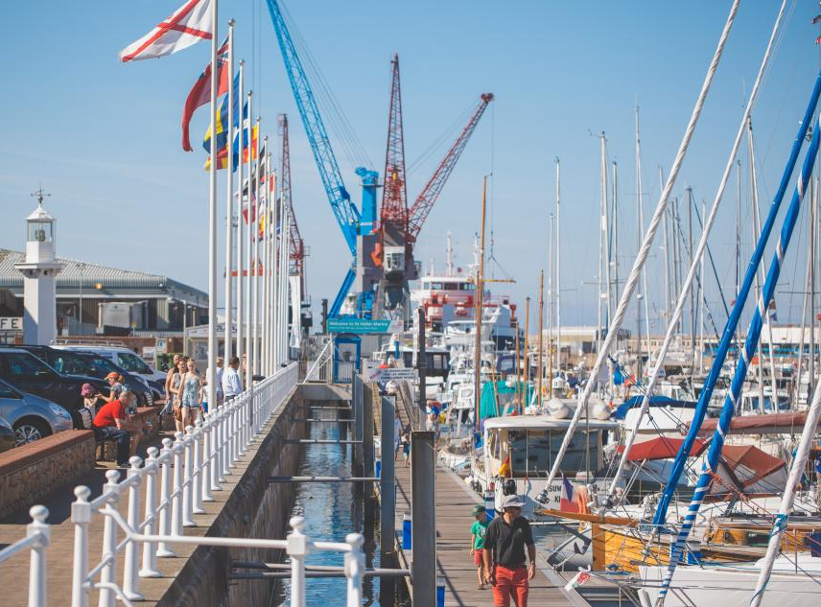
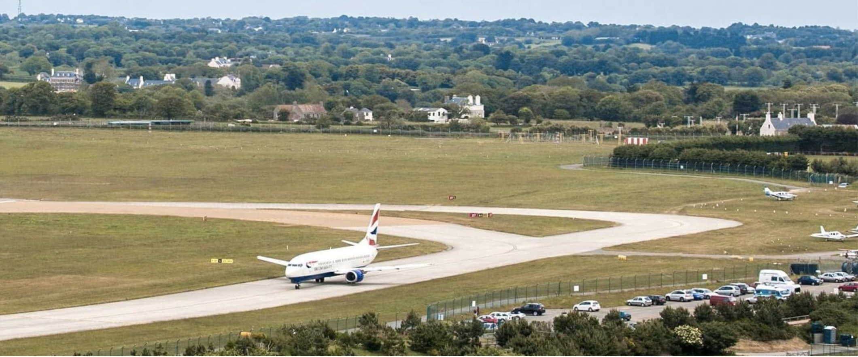
Airport & Harbour

Slide 7

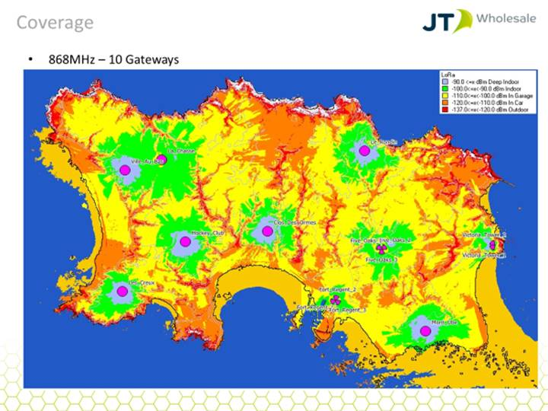





Telecoms & Networks
100% fibre to
the premises
LoRa Coverage
Pan Island IoT Network

Slide 8
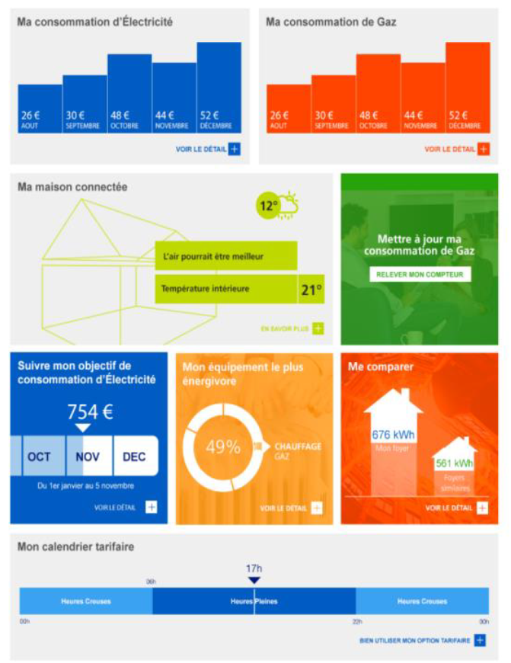
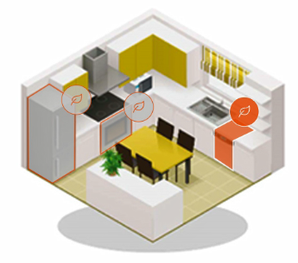



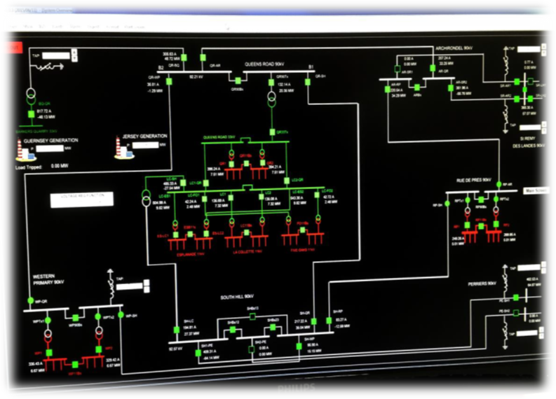
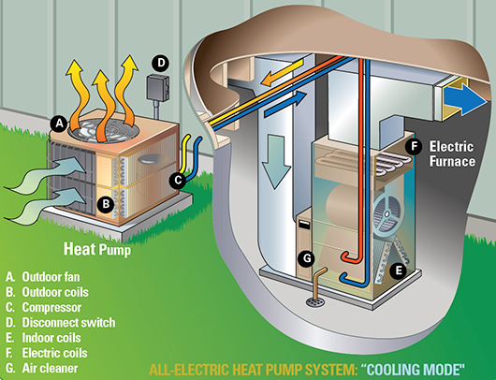
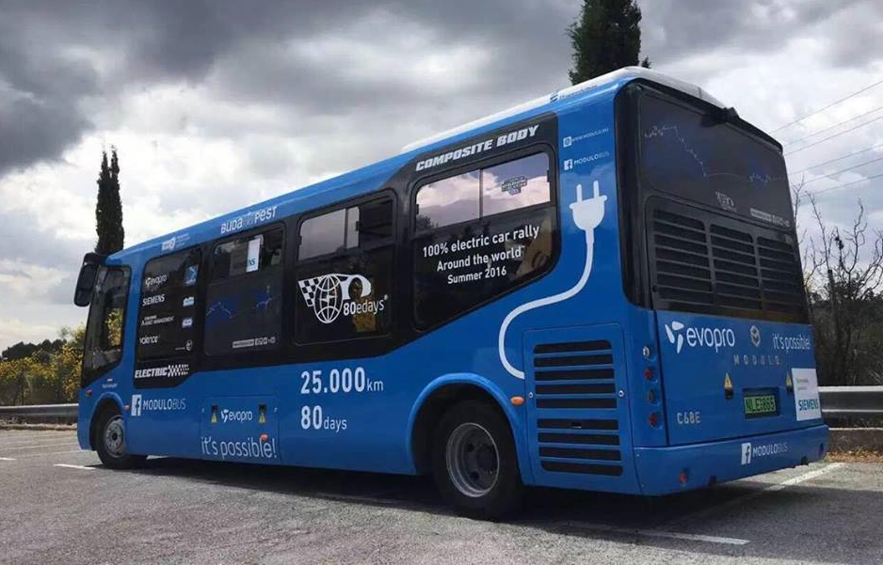
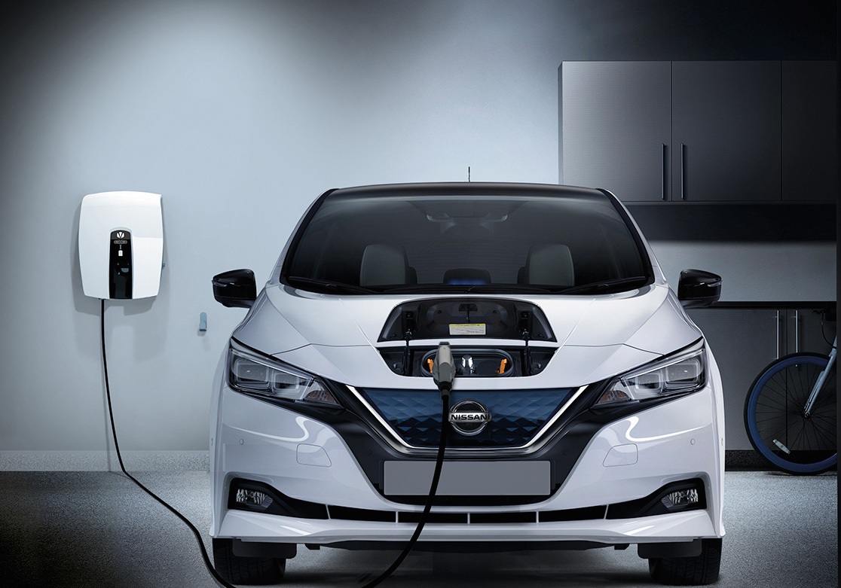
Existing and Future Planned Cable Links
Jersey Electricity

Slide 9
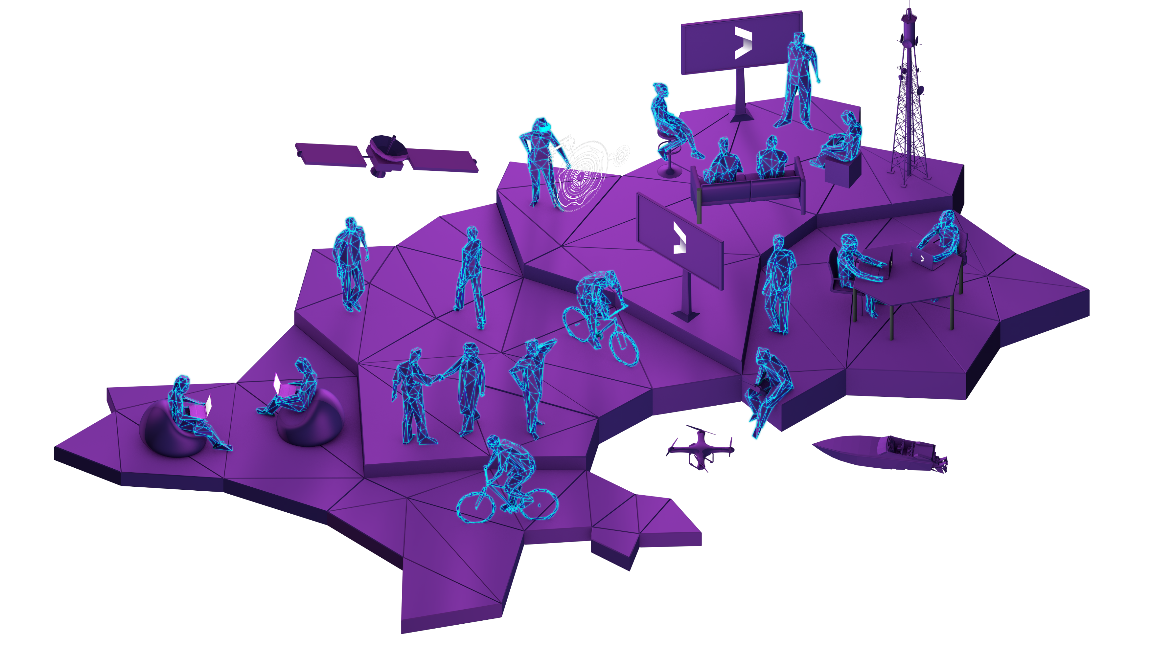
What is Digital Jersey?
Digital Jersey is the government-backed economic development agency and industry association dedicated to the growth
of the digital sector in Jersey.

Slide 10
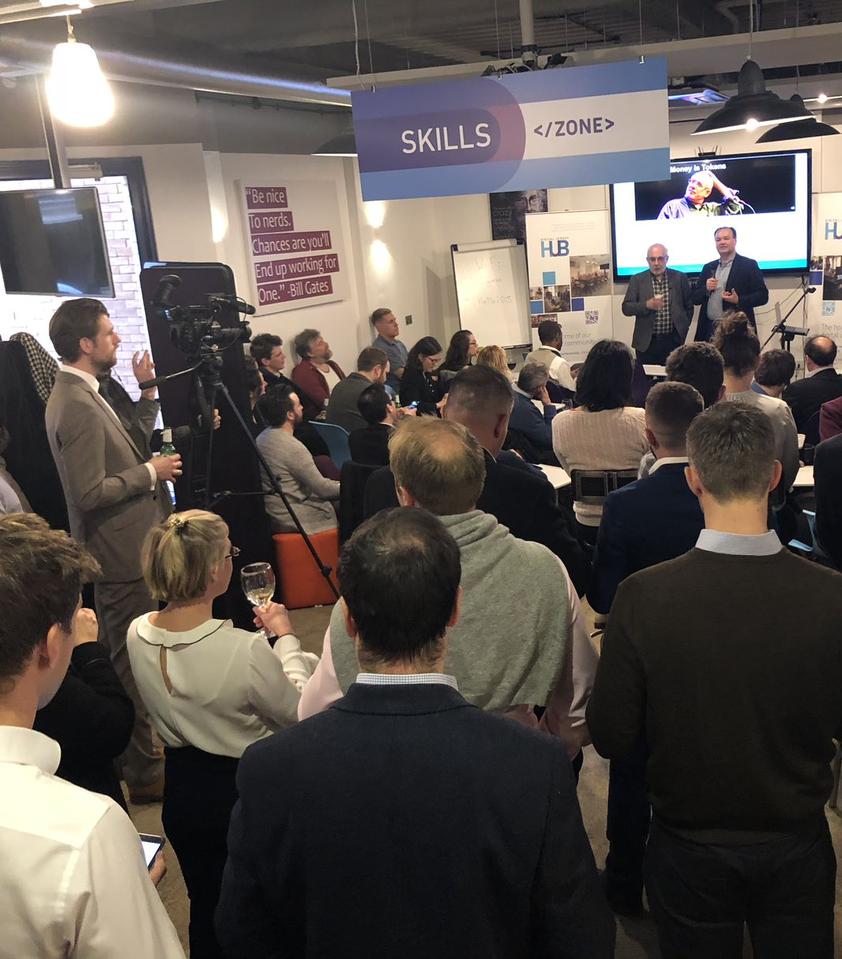



Slide 11
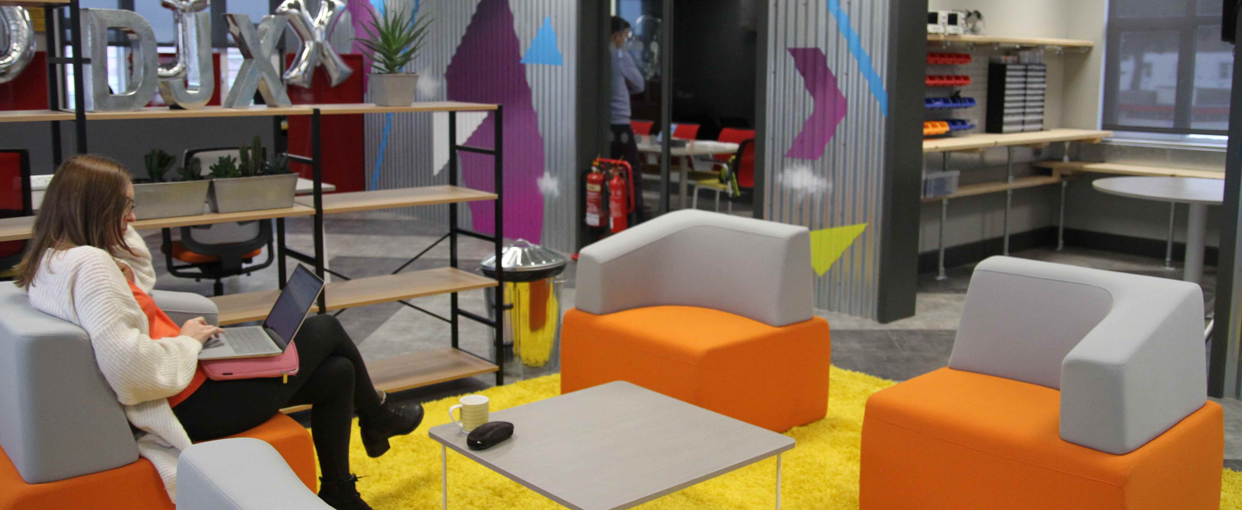

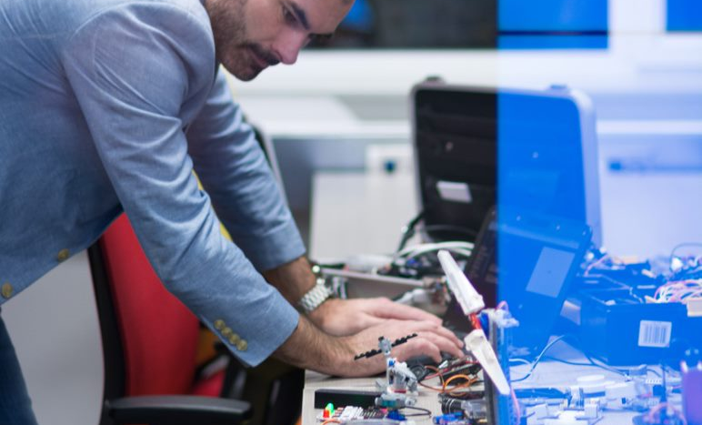
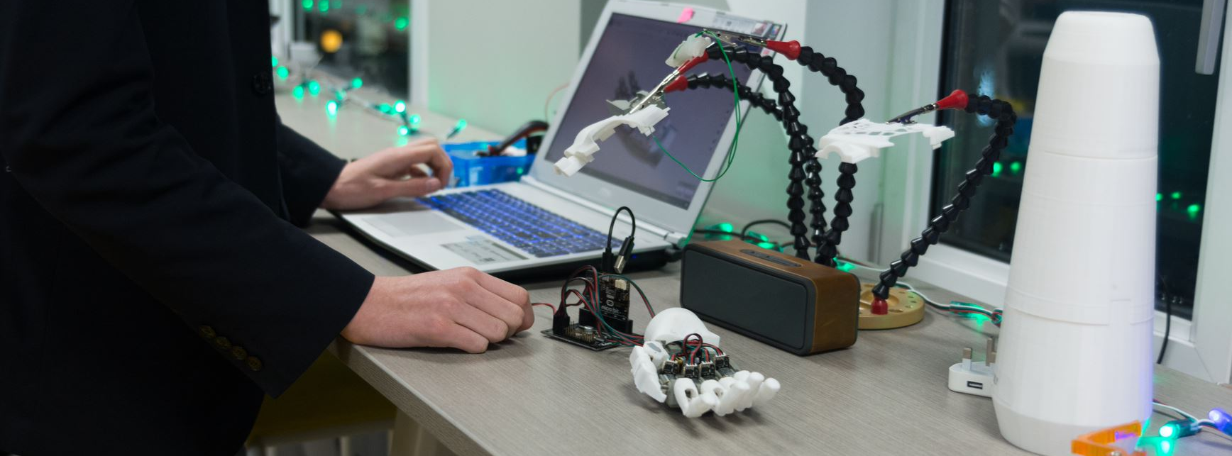

Slide 12


Data Platform
Notes:
DJX will be the physical hub of the IoT community in Jersey
In the process of creating our own IoT data platform or which will be where the important stuff gets done!
Whilst Jersey will never command attention through volume of data points I believe that our USP can be the ability to access and combine multiple diverse data sets which would not be achievable in larger more complex cities or jurisdictions
We hope to create a environment for creativity and entrepreneurism which will develop talent and businesses locally, improving citizen experience whilst building an exemplar for other places!
There are some pieces of the jigsaw missing – Jersey doesn’t currently have a university, but we will forge relationships with best of breed educational establishments such as UCL

Slide 13



Our Initiatives
IoT
Fintech
Digital Health
Notes:
Bit of background – why IoT?
Digital Jersey has 3 strategic priorities
These were decided as a result of a review of best opportunities for Jersey undertaken in conjunction with KPMG
Digital Health & Fintech more obvious but IoT due to growth potential, testbed opportunities and lack of barriers to entry
Improve citizen experience

Slide 14


Slide 15




Fintech Roadmap - Island wide plan for Fintech

Slide 16

Digital Health

Slide 17



Research Partnerships
Notes:
On that note, a massive thank-you to Clive Poole and the UCL team for helping to organise this event… hopefully it’s just the start of a successful ongoing partnership!

Slide 18



Digital Skills

Slide 19









Start-up Support
Seamless Connectivity
A highly developed Infrastructure
Favourable
Tax Structure
Good Health &
Education System
Connected to the World
Culture & Lifestyle
Multiple co-working spaces
Dedicated Support

Slide 20




Case Studies
Sony
Honeywell
Meteomatics
Jersey Royal Company
Notes:
We are looking to increase Jersey’s portfolio of use cases all the time…
These are some of the appliocations to date:
Sony – bespoke LPWAN
Honeywell – Smart Water meters
Meteomatics – weather drones
Jersey Royal Co. – LoRa nutrient sensors & potato blight weather stations

Slide 21
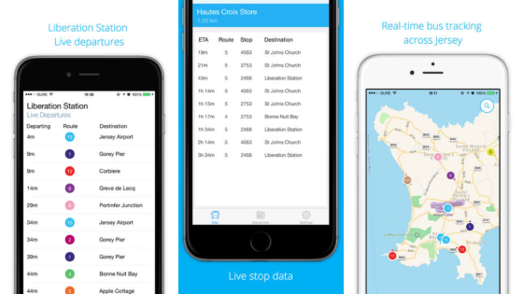
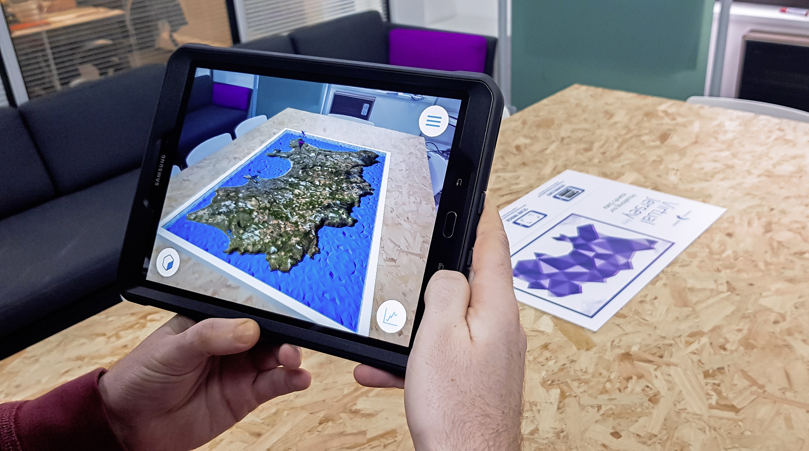



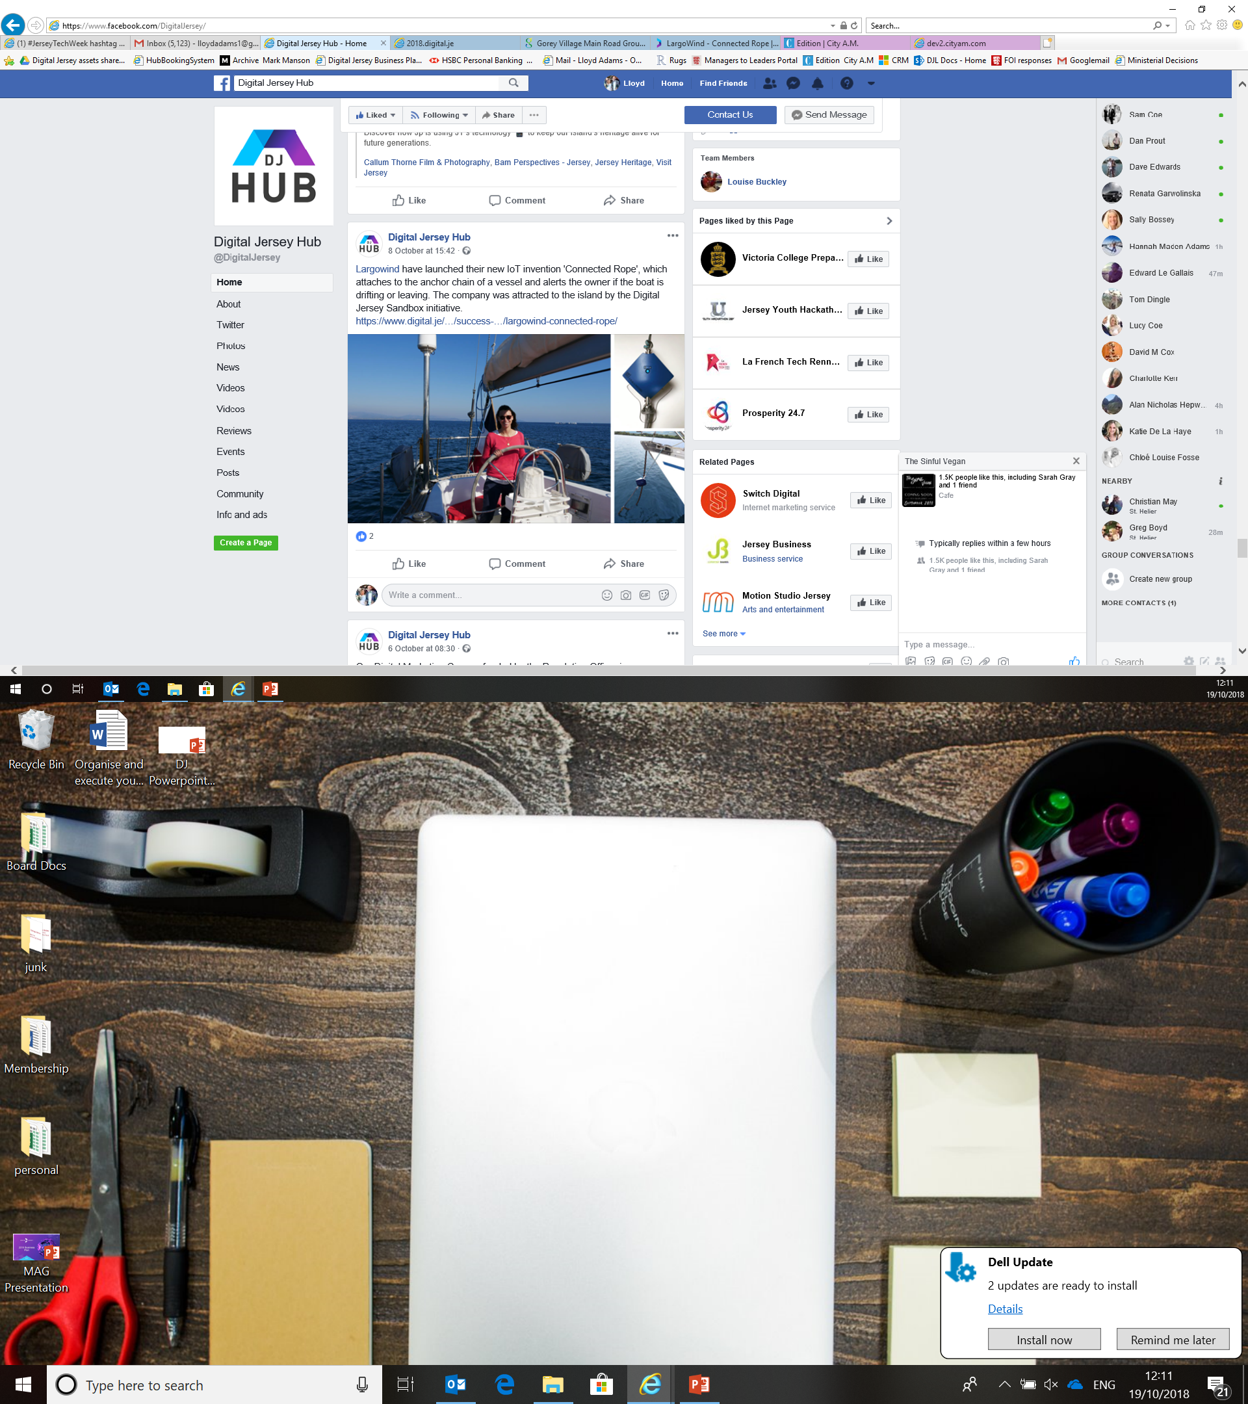

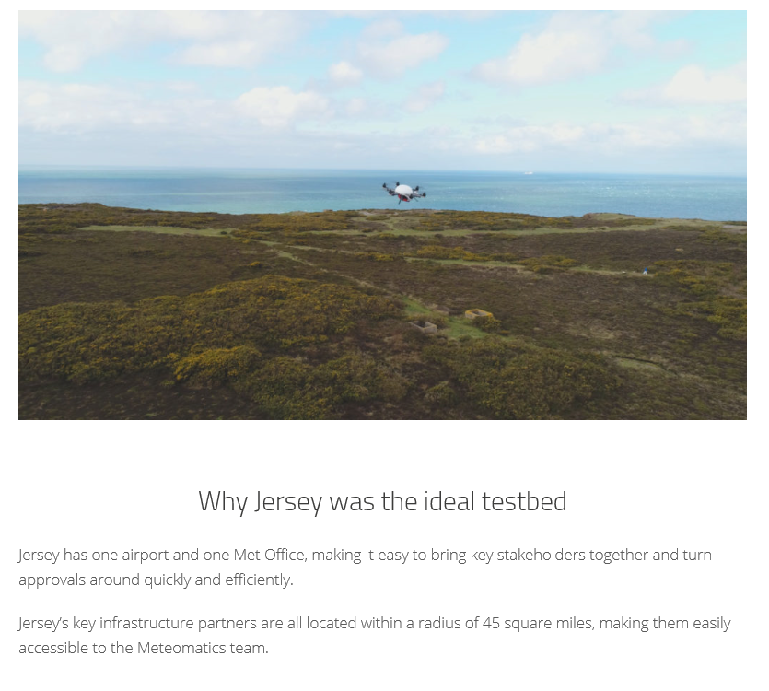


Slide 22
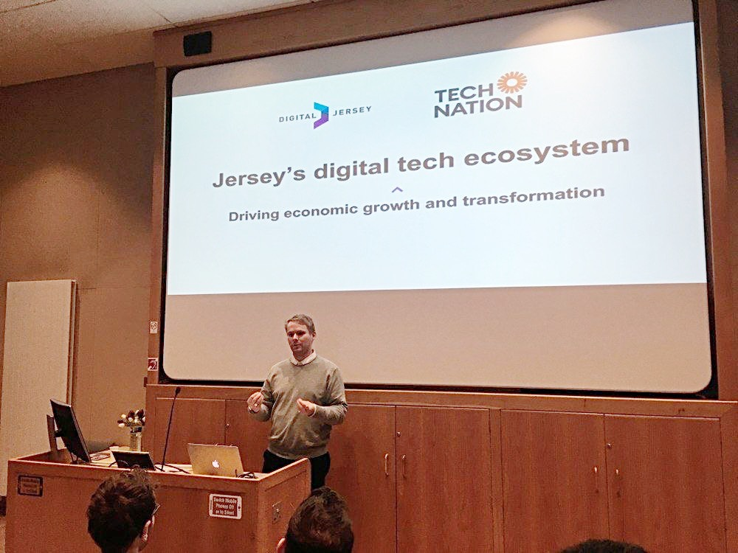
Tech Nation Jersey Report

Slide 23
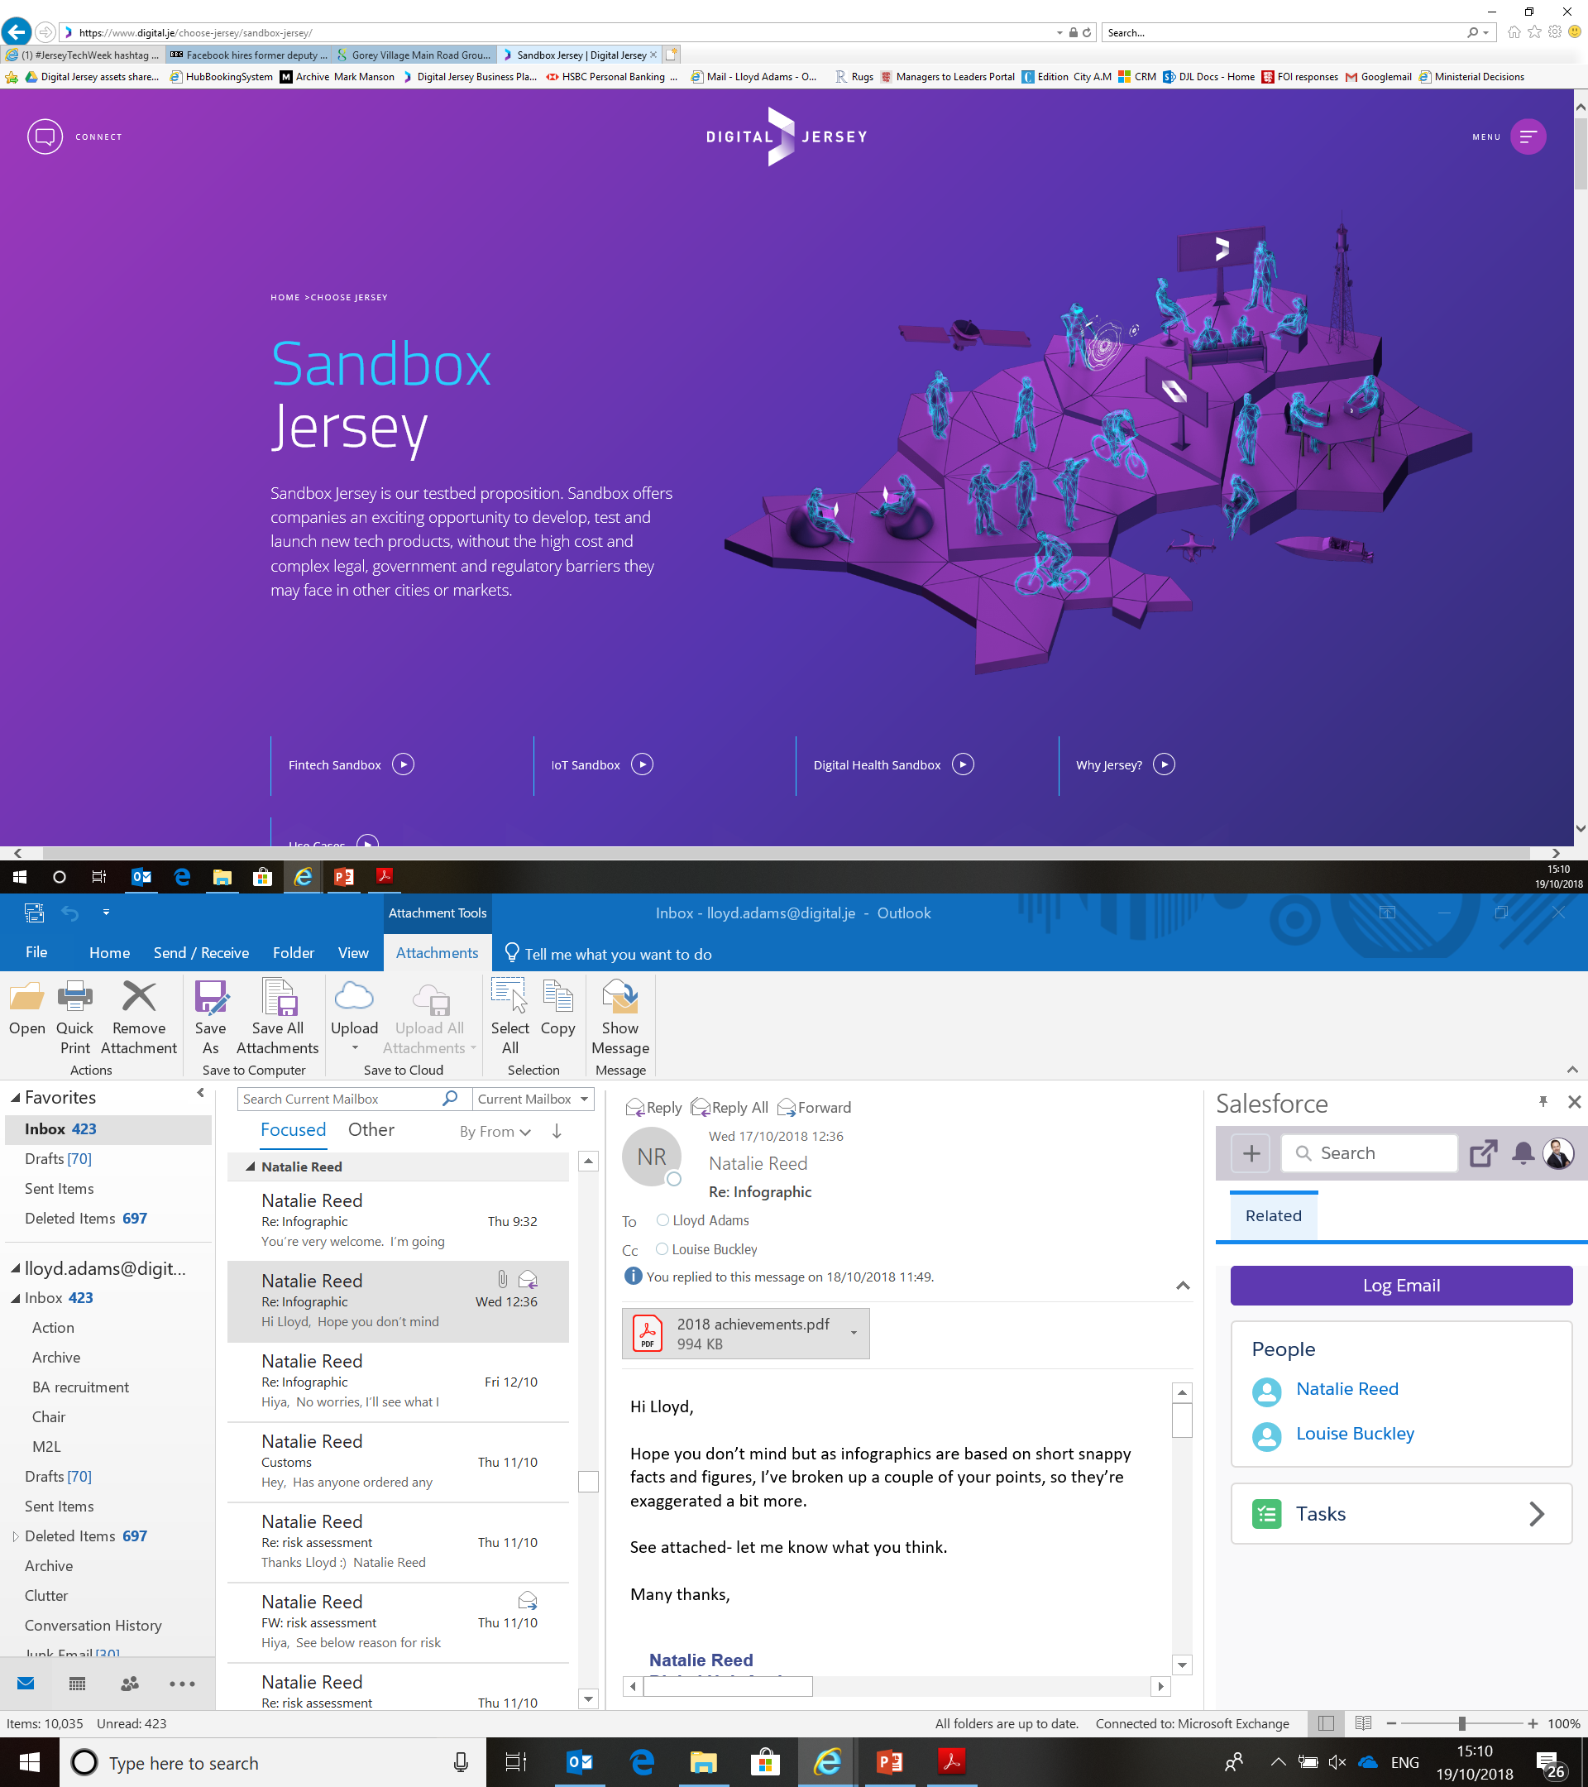

Slide 24
info@digital.je
Get in Touch!

