Slide 1
Perfectly Placed
Dr Austin Gibbs

Slide 2
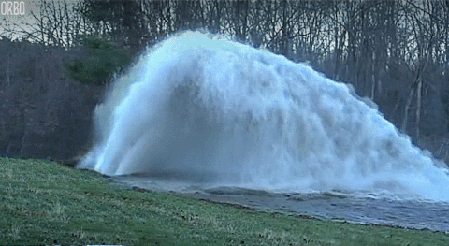
Dr Austin Gibbs

Slide 3
Immersive Technologies
Augmented Reality
Machine Learning
Virtual Reality
Artificial Intelligence

Slide 4
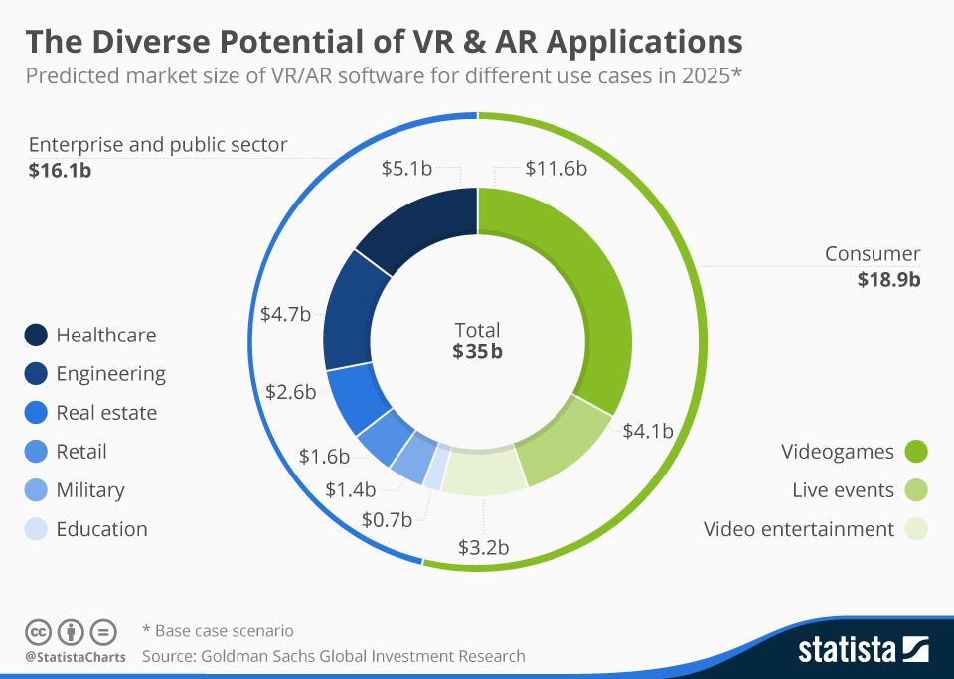
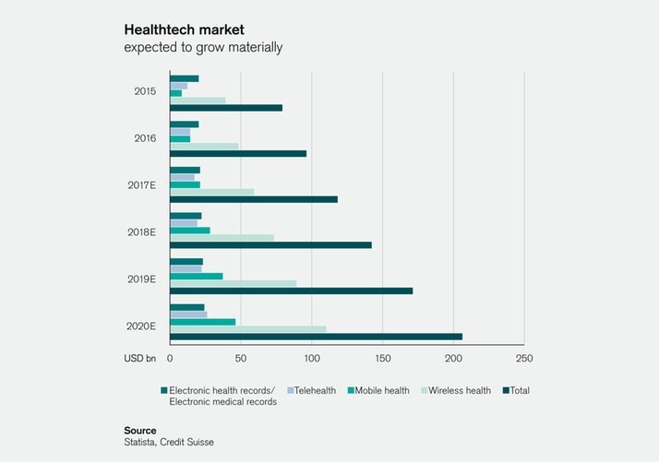

Slide 5


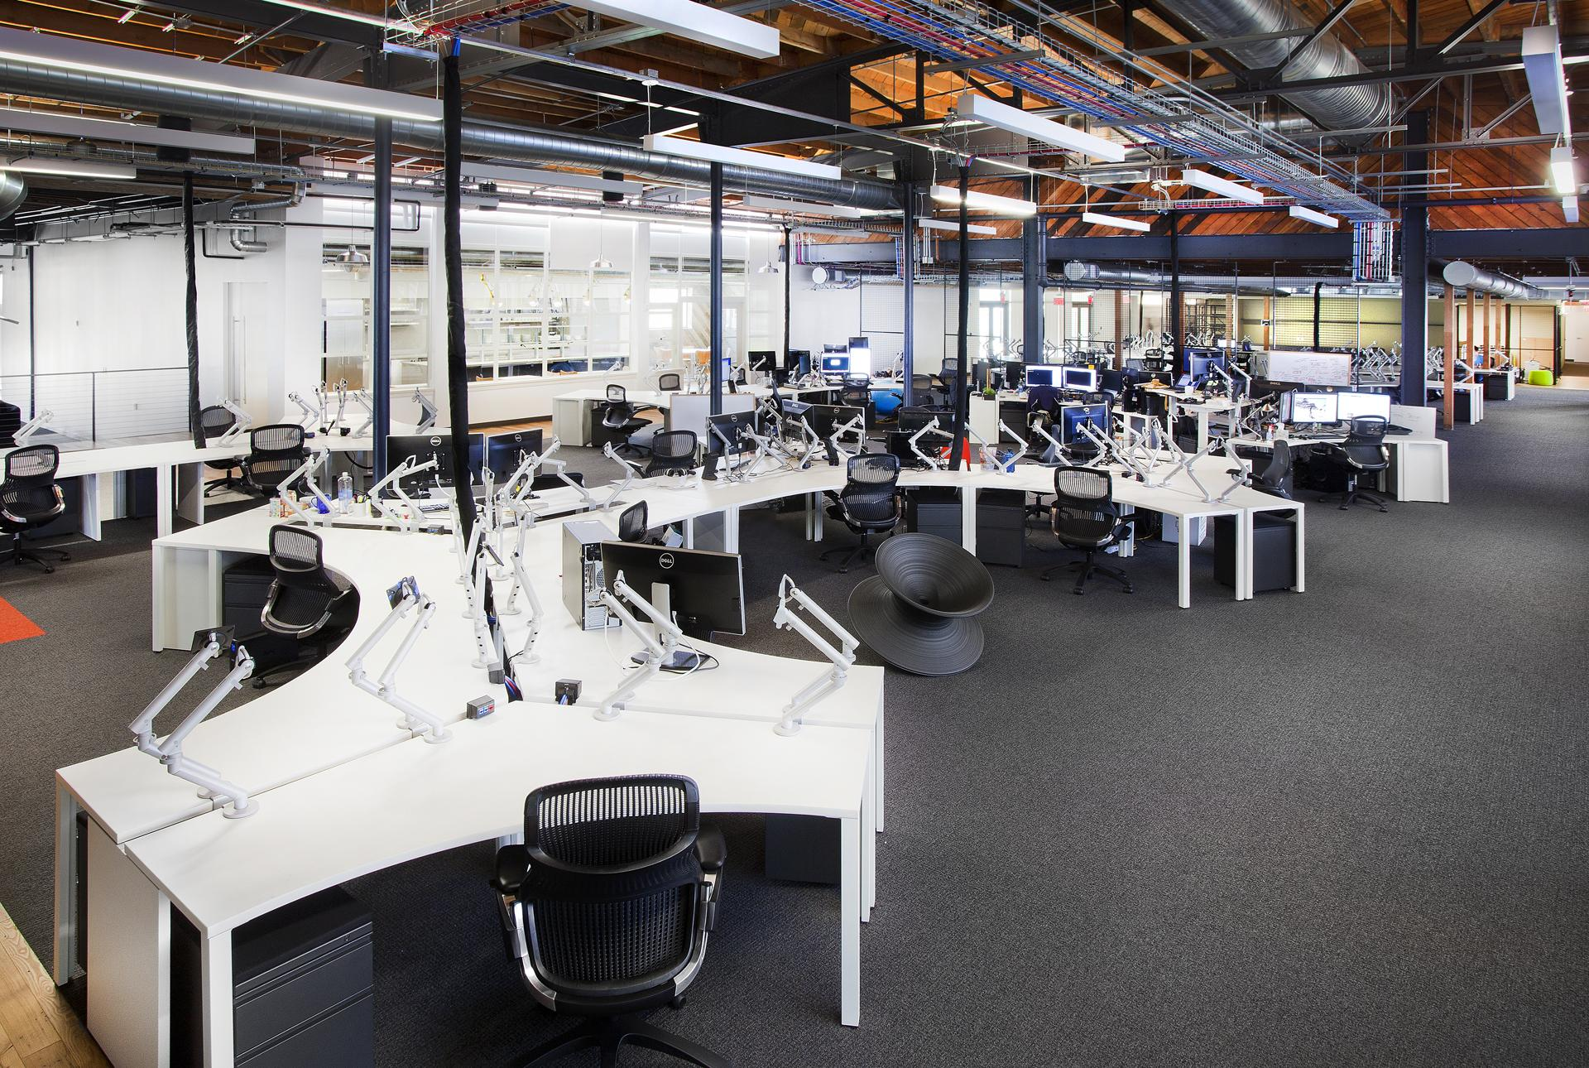
#Sandbox

Slide 6
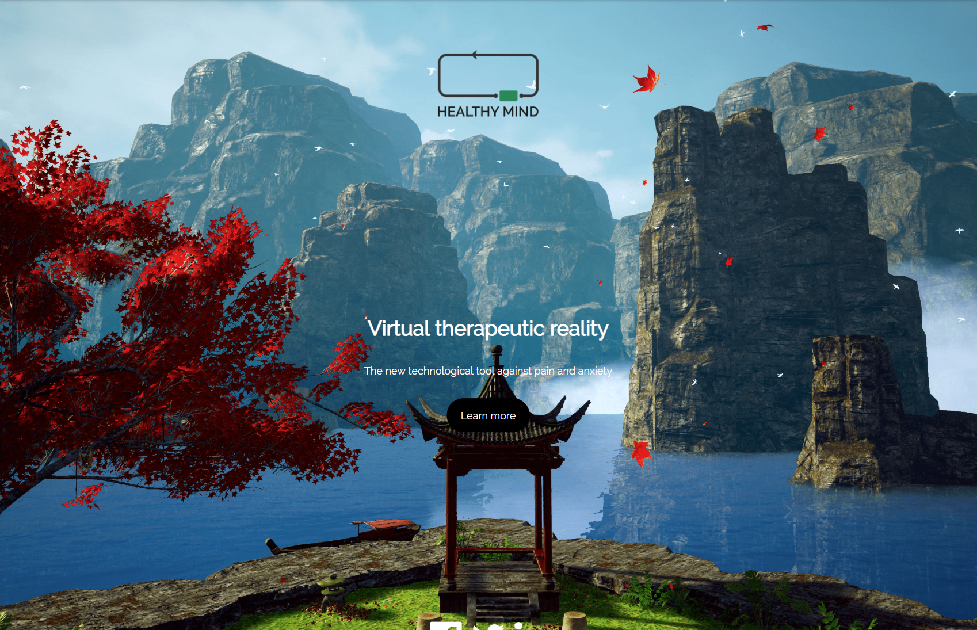

#Sandbox

Slide 7

#Sandbox

Slide 8
Perfectly Placed
Dr Austin Gibbs

Slide 9

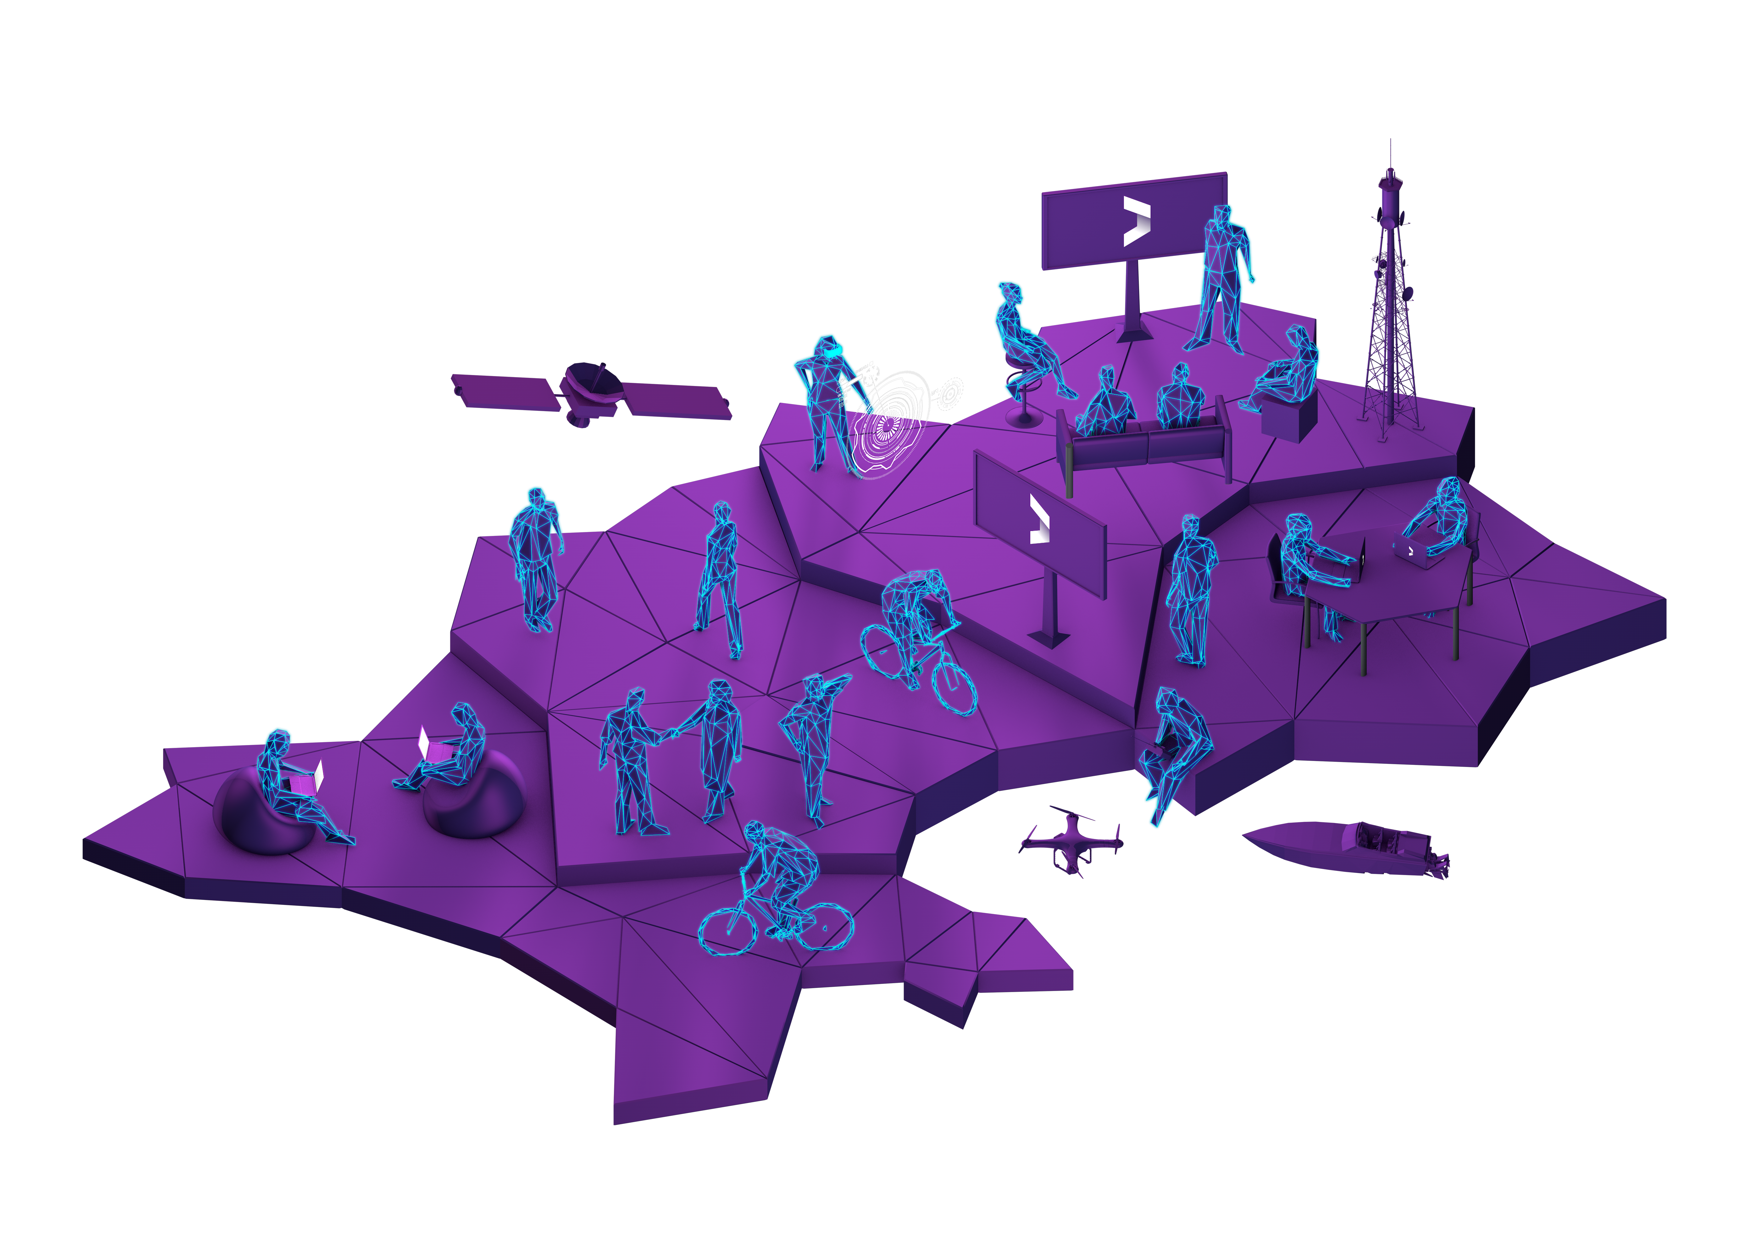



Slide 10
Your panel

Slide 11
Sandbox Jersey
Q & A

Slide 12
Sandbox Jersey
#sandboxjersey

